Slide 1

"A Multi-Hop Model With Retrieval-Augmented Generation and Knowledge Graphs for Research Papers Exploration"
Team No – 1235
Guide - Dr. ROLLA SUBRAMANYAM
21BAI1408- Bavana Durga Praneeth 21BAI1861- Thanga Sai Naga Anirudh
21BAI1352- Bobbili Akarsh

Slide 2
GUIDE APPROVAL

Slide 3
OUTLINE PAGE NO:
. INTRODUCTION (4 slide)
. PROBLEM STATEMENT (5 slide)
. RESEARCH OBJECTIVES (6 slide)
.PROPOSED SYSTEM:
. INTRODUCTION (8 slide)
. ARCHITECTURE (9 slide)
. List Of Modules (10 slide)
.Algorithms (11-15 slides)
.RESULTS (16 slide)
.FUTURE WORK (17 Slide)
.CONCLUSTION (18 Slide)
.REFERENCES (19 Slide)

Slide 4
Introduction
The rapid growth of academic research has made it increasingly difficult to retrieve relevant and trustworthy information efficiently. Traditional Retrieval-Augmented Generation (RAG) systems, while powerful, often rely on unstructured text or vector databases, which lack the ability to capture deep semantic relationships between entities.
This leads to limitations in contextual understanding, accuracy, and explainability. To address these challenges, our project proposes a novel approach that integrates Knowledge Graphs (KGs) into the RAG framework. By leveraging the structured, relational nature of KGs, our system enhances the retrieval process and enables the generation of more accurate, interpretable, and context-aware responses—particularly useful in domains like academic research, where reliability and reasoning are critical.

Slide 5
Problem Statement
Researchers struggle with efficiently exploring academic literature due to the limitations of traditional NLP models, which fail to retrieve and connect related papers effectively. Manual searching is time-consuming, existing chatbots lack multi-hop reasoning, and scalability issues hinder processing large datasets . This project addresses these challenges by integrating Retrieval-Augmented Generation (RAG) with a Knowledge Graph (Neo4j) for intelligent, multi-hop research exploration.

Slide 6
Objective
Develop a Multi-Hop Chatbot that integrates Hugging Face RAG and Neo4j Knowledge Graphs for intelligent research paper exploration.
Enhance Multi-Hop Reasoning to improve contextual linking of research papers.
Optimize Performance using graph-based retrieval and transformer-based embeddings

Slide 7
DATASET
https://www.kaggle.com/datasets/nechbamohammed/research-papers-dataset

Slide 8
Proposed System
The proposed system is a multi-hop chatbot that leverages Retrieval-Augmented Generation (RAG) and Knowledge Graphs (Neo4j) to enhance research paper exploration. Unlike traditional NLP-based search systems, this approach enables context-aware, multi-step reasoning by retrieving interconnected research papers through both vector-based semantic search (FAISS/Pinecone) and structured graph-based queries (Neo4j). By integrating Builder RAG, the system optimizes retrieval efficiency, response accuracy, and explainability, ensuring that AI-generated answers are backed by traceable sources. This advanced research assistant significantly reduces the time and effort required for literature review while improving the quality and depth of insights.

Slide 9
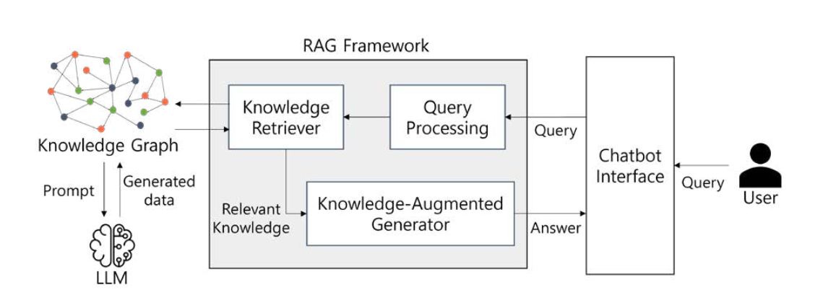
Proposed System Architecture

Slide 10
List of Modules
Knowledge Graph Construction (Neo4j)
LLM based RAG Integration
Multi-Hop Question Answering (MHQA)
Vector Search & Embeddings (FAISS/Pinecone)
Final Answer Generation & Explainability

Slide 11
Data Collection & Preprocessing Module
Functionality: Gathers research papers and processes them for structured storage.
Algorithms Used:
Text Preprocessing (Tokenization, Stopword Removal, Lemmatization - NLTK, spaCy)
Named Entity Recognition (NER) (BERT-based NER for author/topic extraction)
Embedding Generation (BERT/Transformers for vector representation – Hugging Face)

Slide 12
Knowledge Graph (Neo4j) Construction Module
Functionality: Builds a Neo4j-based Knowledge Graph (KG) to store and structure relationships between research papers.
Graph Nodes Represent:
Research Papers, Authors, Keywords, Citations, Topics, and Institutions.
Graph Edges Define Relationships:
Paper A is cited by Paper B, Author X wrote Paper Y, Topic T is covered in Paper Z.

Slide 13
Retrieval-Augmented Generation (RAG) with Builder RAG
Functionality: Generates natural language responses by integrating retrieved documents into a pre-trained RAG model.
Algorithms Used:
Hugging Face RAG Model (BART + Dense Retriever for retrieval + generation pipeline)
Builder RAG Customization
1) Fine-tuning on research datasets to improve domain-specific responses.
2) Dynamic reranking of retrieved documents based on query context.

Slide 14
Multi-Hop Question Answering (MHQA) in RAG with Knowledge Graphs
Overview
MHQA enables answering complex queries by retrieving and reasoning across multiple documents/nodes.
Knowledge Graphs (KGs) help structure information for efficient retrieval.
How It Works
Query Decomposition → Breaks down complex questions into sub-queries.
Graph-Based Retrieval → Finds relevant entities & relationships using vector search.
Multi-Step Reasoning → Uses LLM to generate a final answer after cross-referencing facts

Slide 15
Vector Search, Embeddings & Final Answer Generation
Vector Search & Embeddings
Converts text, entities, and relations into high-dimensional embeddings.
Uses FAISS or ANN for fast retrieval in large datasets.
Enhances RAG by ranking most relevant knowledge graph nodes.
Final Answer Generation & Explainability
Aggregates retrieved knowledge from KGs & external sources.
Ensures explainability by showing the reasoning path & supporting evidence.
Uses LLM mini for concise, accurate answers.

Slide 16
Results

Slide 17
Future Work
In the next phase of development, our focus will be on scaling the knowledge graph by expanding the research paper database. This includes integrating larger and more diverse datasets from open-access repositories like arXiv, Semantic Scholar, and PubMed. To support this, we plan to implement an automated ingestion pipeline that regularly fetches new research papers, extracts relevant metadata using NLP techniques, and dynamically updates the graph in real-time.
This will involve automating Named Entity Recognition (NER), relationship extraction, and graph construction, allowing the system to remain current without manual intervention. Additionally, we aim to improve entity disambiguation to prevent duplication and enhance the quality of the graph. These upgrades will make the system robust, scalable, and suitable for long-term deployment in academic and enterprise environments.

Slide 18
Conclusion
This project presents a novel integration of Knowledge Graphs (KGs) with Retrieval-Augmented Generation (RAG) to address the limitations of traditional retrieval systems in academic research. By constructing a domain-specific knowledge graph and combining it with semantic search techniques, we significantly improved the accuracy, contextual relevance, and interpretability of generated responses.
Our hybrid approach enables the system to understand and reason over relationships between research entities, leading to more reliable and fact-based outputs. The experimental results validate the effectiveness of our model, particularly in handling complex, multi-hop queries. Overall, the project demonstrates the potential of KG-RAG frameworks in building intelligent, explainable, and scalable research exploration tools.

Slide 19
References
Patrick Lewis, Ethan Perez, Aleksandra Piktus, et al. (2024). Retrieval-Augmented Generation for Knowledge-Intensive NLP Tasks.
Lei Liu (2024). Construction of Programming Knowledge Graph Based on Student Knowledge Needs.
J. Benita, Kosireddy Vivek Charan Tej, E. Vinay Kumar (2024). Implementation of RAG in Chatbot Systems for Enhanced Real-Time Customer Support in E-Commerce.
Kunal Sawarkar, Abhilasha Mangal (2024). Blended RAG: Improving RAG Accuracy with Semantic Search and Hybrid Query-Based Retrievers.
Pankaj Joshi, Pankaj Kumar (2024). Robust Multi-Model RAG Pipeline for Documents Containing Text, Table & Images.
Yongping Du, Xingnan Jin, Zikai Wang (2024). A Novel RAG Framework with Knowledge Enhancement for Biomedical Question Answering. IEEE International Conference on Bioinformatics and Biomedicine (BIBM).
Huadong Lin, Yirong Chen, Wenyu Tao, Mingyu Chen, Xiangmin Xu, Xiaofen Xing (2024). Domain Adaptation and Unified Knowledge Base for RAG in Dialog Systems.

